Slide 1
PARKSIDE DANCE ACADEMY, 2026 SHOWCASE
Appalachian Spring
A production book. Academy Theater, February 6 to 8, 2026.
Choreography by Jason Cooper . Rehearsal direction by Chris Reynolds
01 / 07

Slide 2
THE WORK
Spareness, on purpose
Martha Graham first danced this on a bare stage in 1944. We kept that spareness on purpose. No scrim, no projection, one bench.
Everything you feel should come from the body and the score, which is the standard we hold every day in the studio.
02 / 07

Slide 3
THE PROGRAM
Four movements
Movement | Forces
I. Variations on a Shaker Theme | Levels 5 and 6
II. The Bride and Her Intended | pas de deux
III. The Revivalist and His Flock | full company
IV. Day's End, adagio | full company
RUNTIME BY MOVEMENT, MINUTES
Thirty two minutes across four movements
03 / 07

Slide 4
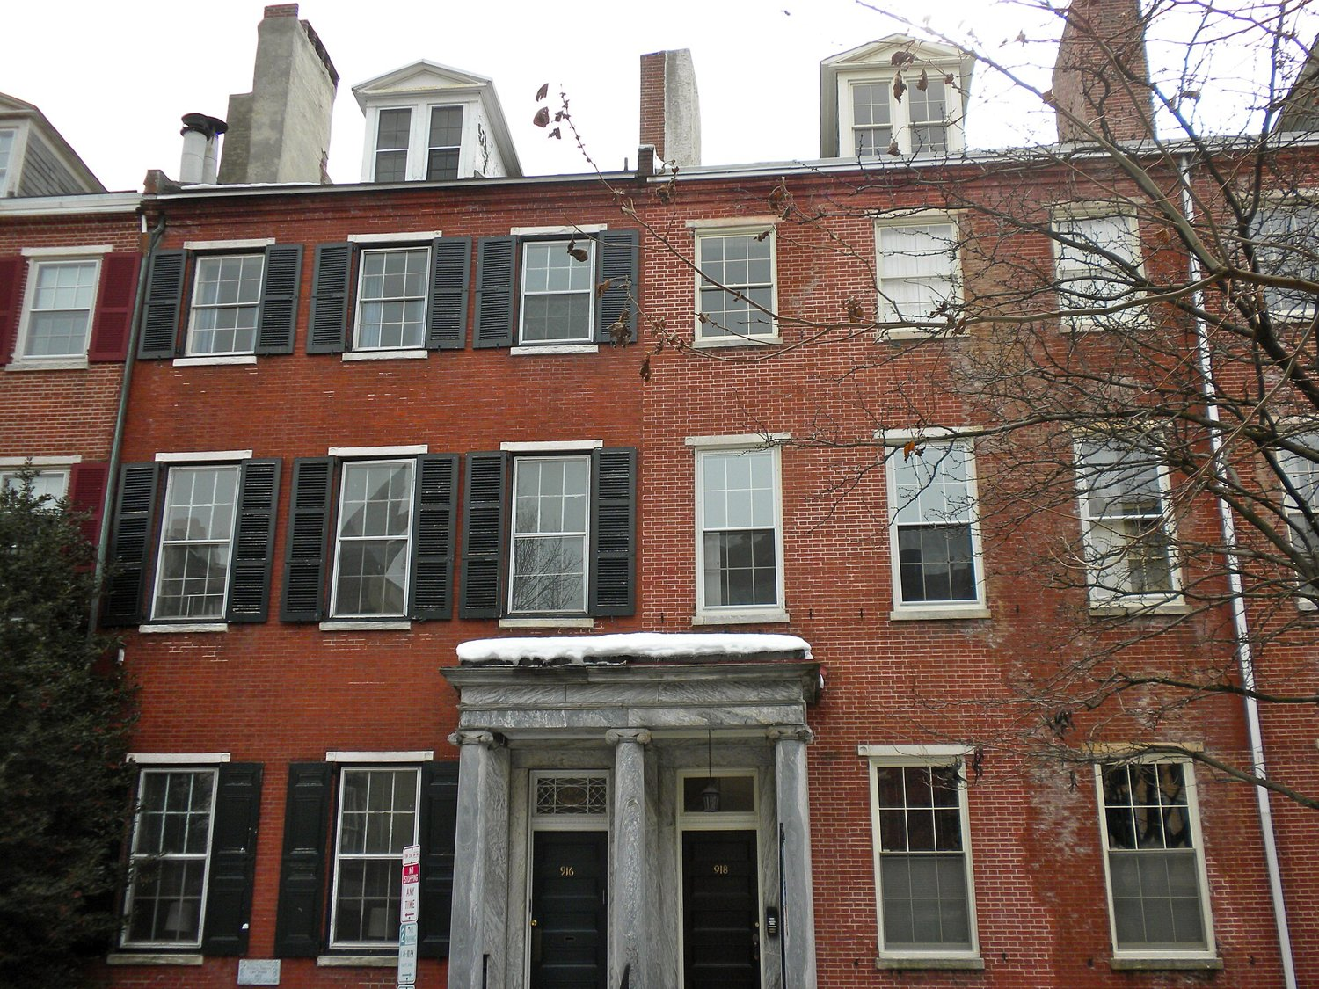
THE COMPANY
Thirty two dancers
A cast of thirty two dancers, ages twelve to eighteen, across Levels 5 and 6.
Eleven weeks of rehearsal to learn that the hardest thing a young dancer can do is wait.
Fairmount, Philadelphia
04 / 07

Slide 5
PRODUCTION AND BUDGET
Costumes by Lisa Thompson, a $4,800 budget
Spent $3,430 of $4,800
Lighting by Dave Marshall.
Music, a licensed Aaron Copland arrangement, $1,200 paid in full.
Quick changes tested under ninety seconds, stage left wing.
05 / 07

Slide 6
BY THE NUMBERS
The run, counted
32
dancers
4
movements
8
performances
11
weeks of rehearsal
$4,800
costume budget
$1,200
music license
06 / 07

Slide 7
With gratitude to the parents
who drove the late pickups and learned to sew a hook and eye in the dark.
07 / 07

